Slide 1
Origami

Slide 2
What is origami art?
-Traditional origami is the art of folding a paper into a 3 Dimensional sculpture without cutting, tapping or even gluing it.
-Comes from the Japanese words
ori- folding
kami-paper

Slide 3
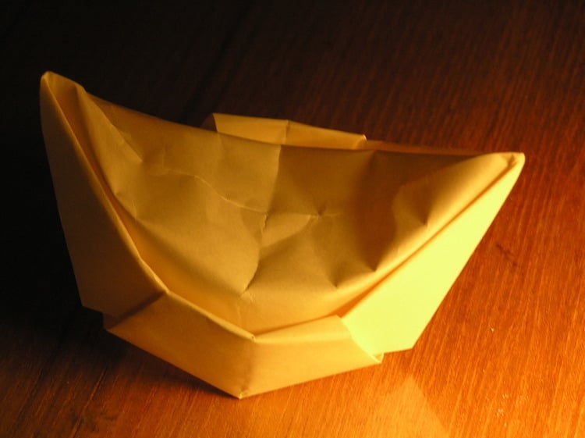
What is origami art?
-Paper was invented in China around 105 AD and folded paper or (zhezhi) emerged shortly after.
-By 900 AD gold nuggets were a staple at traditional Chinese funerals.
-These ornaments were crafted with the intention of being thrown into a fire at the end of a ceremony.

Slide 4
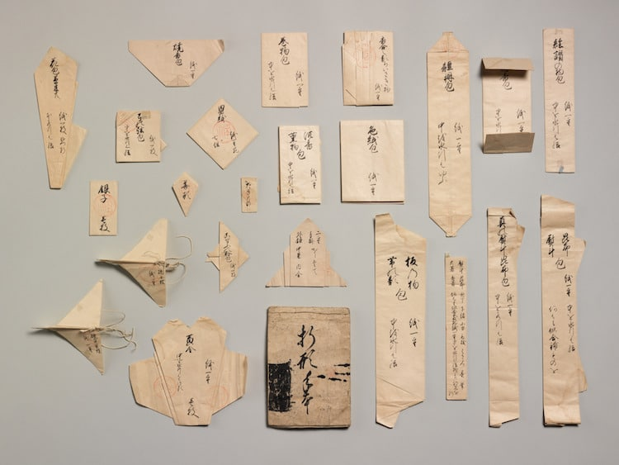
What is origami art?
-Paper folding was introduced to Japan as a ceremonial Shinto ritual. In the Endo period in 1603-1868 it became a leisurely activity.
-Origami works often featured flowers, birds and nature based motifs.

Slide 5
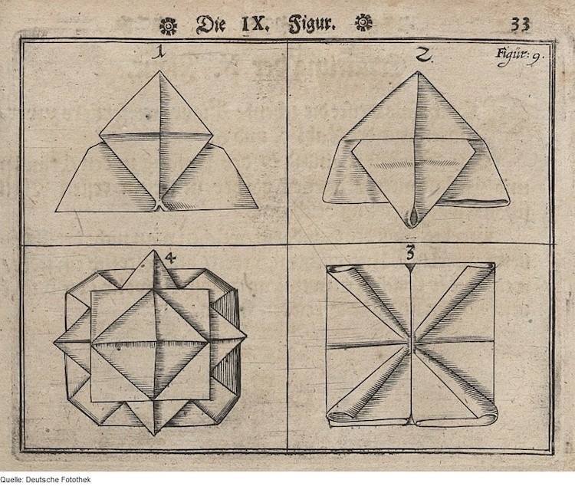
What is origami art?
-In Europe paper folding was adopted in the 17th century and was thought to have been adapted from napkin folding techniques.
-The interest in paper folding eventually moved beyond napkins at dinner parties into Friedrich Froebel's curriculum.
-He created several hands-on-activities that included “play and activity” institutes including paper-folding. This familiarize children with origami and allowed it to flourish across the continent.

Slide 6
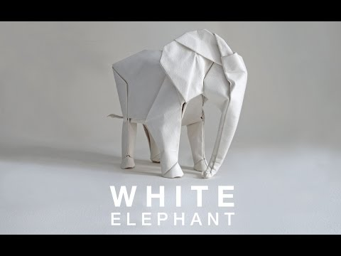
Sipho Mabona

Slide 7
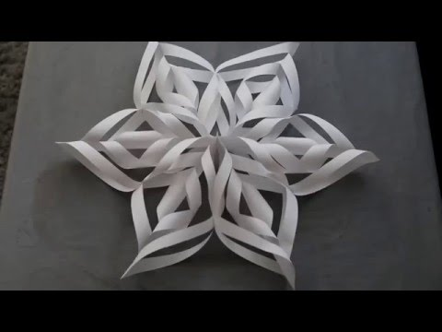
How to Create Origami Snowflakes

Slide 8
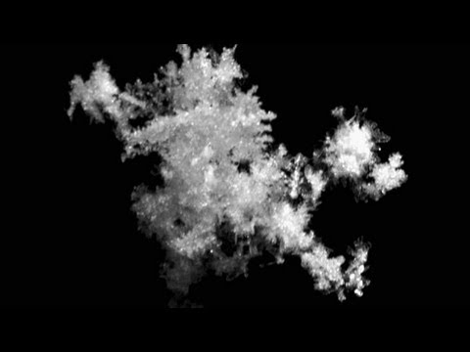
How are Snowflakes Unique?

