Slide 1
Chester Valley Elementary
Annual Title I Meeting

Slide 2
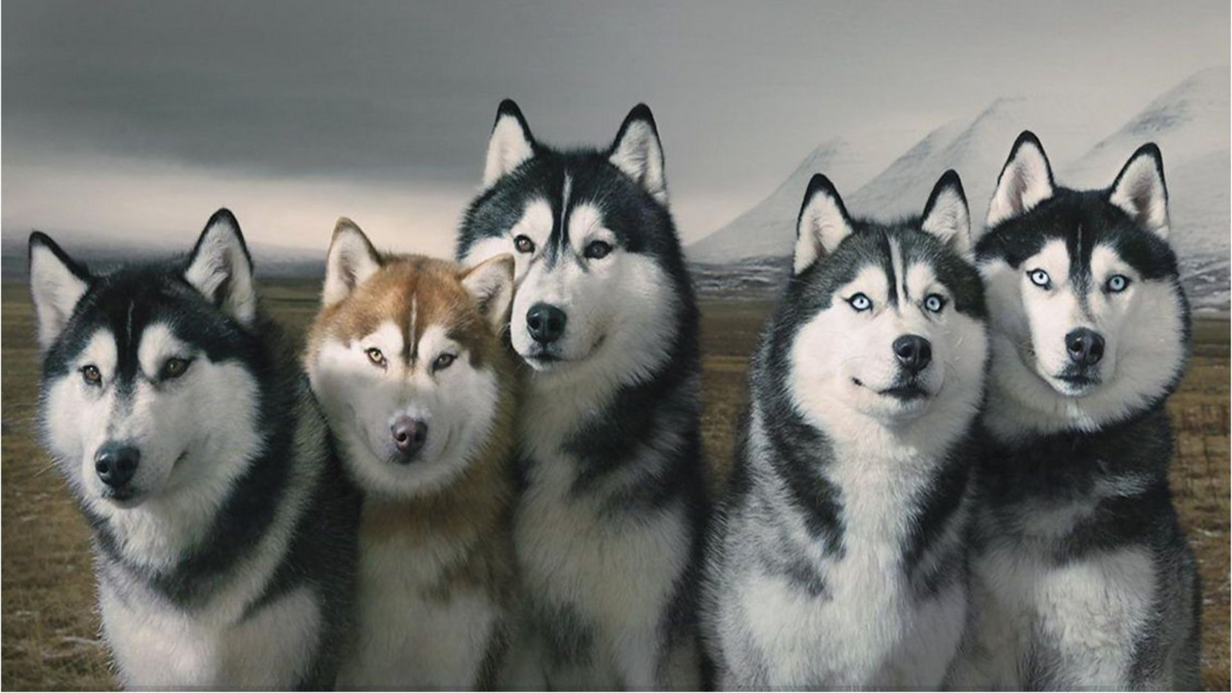
Welcome and Thank You
Huskies are a pack animal! That means we are family! We support and take care of each other. No matter what!

Slide 3
Land Acknowledgement
Before we begin, I would like to acknowledge with gratitude the Dena’ina people, past and present, who have lived on these lands since long before Anchorage was here. May we all be good stewards of these lands. Chin’an.

Slide 5
Agenda
Welcome
What is Title 1 and how we use Funds
District Data Goals
Chester Valley Data
Family Engagement

Slide 6
What is Title I?
A Title 1 school receives additional money from the federal government provided to schools that have a high percentage of students that qualify for free or reduced-price lunch.

Slide 7
Purpose of Title I
Provide additional supports to students in need, to ensure they are successful in school.

Slide 8
How Our School Uses Title I Funds
Behavior Coach
Interventionists and Teacher Assistants (Critical support to grade level teams)
Added Duty (PD to prepare for school start)
Classroom Supplies
Addendums for PD (professional development)
Addendums for before school clubs or student activities
Office Supplies
Artist in Residence

Slide 9
Learning Target/District Goals

Slide 10
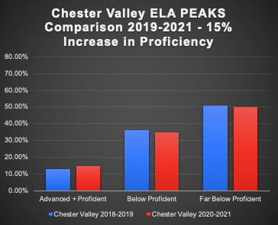
Chester Valley’s Progress & District Goals

Slide 11
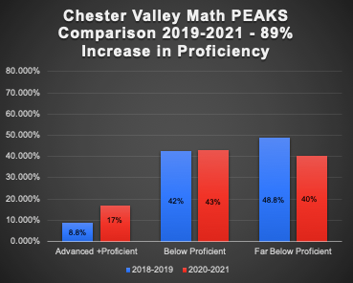
Chester Valley’s Progress & District Goals

Slide 12
Title 1 Goals 2021-2022
2021-2022 Goal: Maintain 5% or LESS of Chester Valley students suspended annually.
2021-2022 Goal: Align academic goals with district goals - Leadership Team coming soon.
2021-2022 Goal: Increase student feelings of “I am safe at school” by 2 points on the students climate survey.

Slide 13
Chester Valley Innovative Programs
After School Program (20 seats grades K-5)
STREAM
Artist in Residence
Writing K-5

Slide 14
Family Engagement
Our partnership with families and family engagement is critical to the success of our students and school. We recognize the additional challenges that distance learning is placing on our families and cannot emphasize enough how grateful we are for how well our families are doing and how supportive our families have been.
Ways to Engage
Title I Planning Team (add in Q&A)
Guest Readers
Respond to Surveys
Notes:
Poll for communication

Slide 15
Thank You
Gratitude for Our Community
Thank You!!!
Our grown-ups (parents, grandparents, guardians, etc.)
School Business Partnerships:
Brown’s Electric
Campfire
All Nations United Methodist Church
United Way
Alaska Behavioral Health

